Slide 1
Building Resilient Data Pipelines An introduction to Building Data Pipelines in Go on Kubernetes
Grant Griffiths
Software Engineer
Platform Cloud Engineering
GE Digital

Slide 2

Who am I?
GE Digital - Platform Cloud Engineering
Sr. Software Engineer
San Francisco, CA
GE Go User Group
Founder & Organizer
@ggriffiths
@griffithsgrant
Climbing + Mountaineering

Slide 3
What we’ll cover
Industrial IoT and Data @ GE
Introduction to Data Pipelines
Sample Data Pipeline in Go
Resiliency Testing our Data Pipeline
Results and takeaways

Slide 4
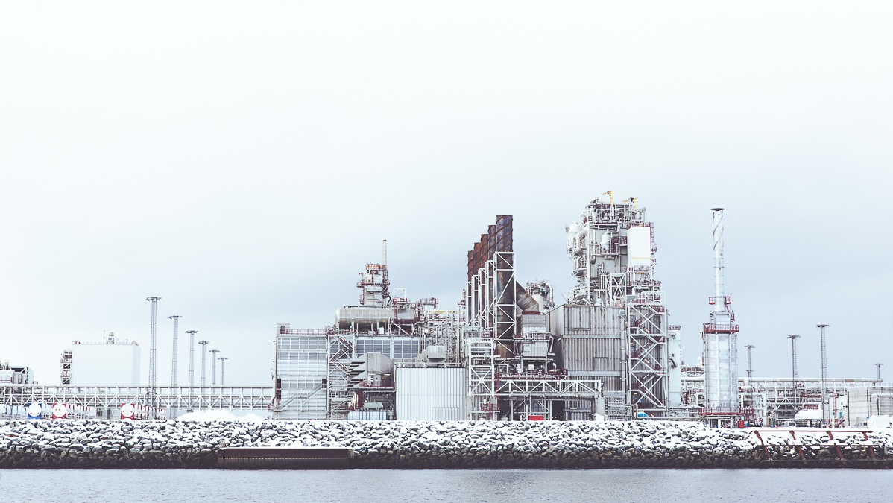
Industrial IoT and Data @ GE
Introduction to Data Pipelines
Sample Data Pipeline in Go
Reliability Testing our Data Pipeline
Results and takeaways

Slide 5
Who here has owned a GE
Fridge, Lightbulb, or Microwave?

Slide 6
Actually, we make
HUGE Industrial assets…

Slide 7
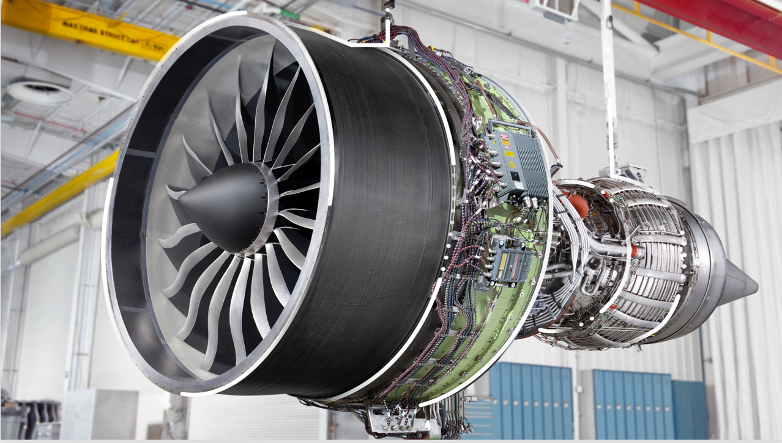

Slide 8
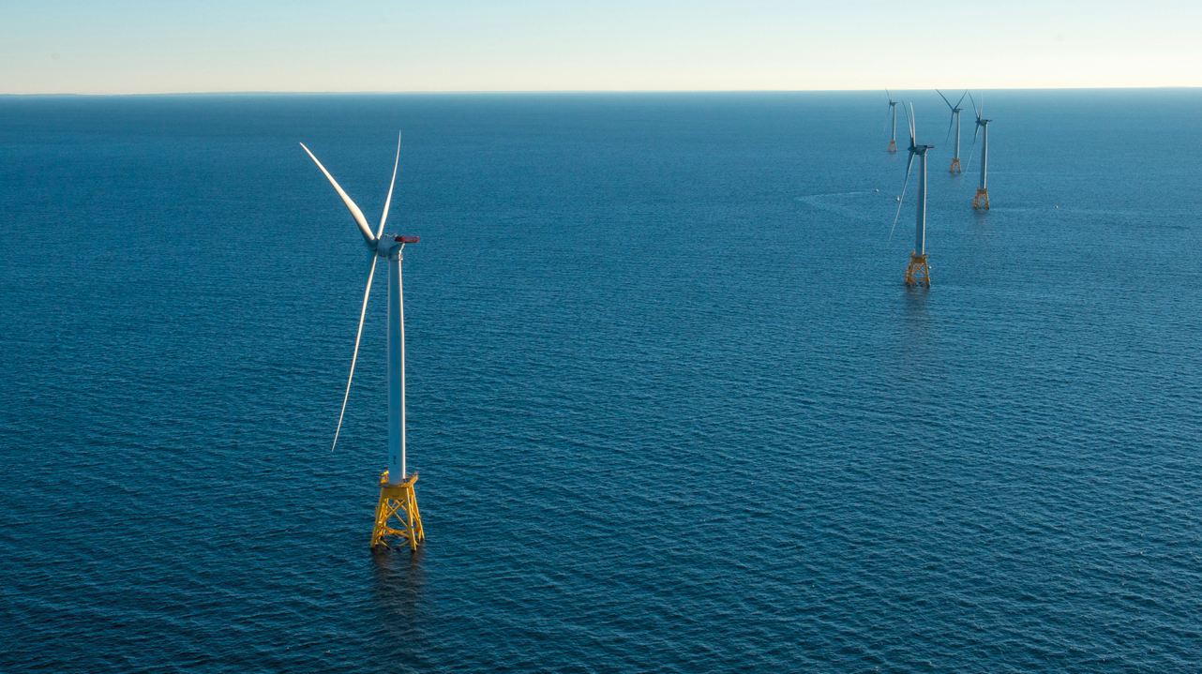

Slide 9
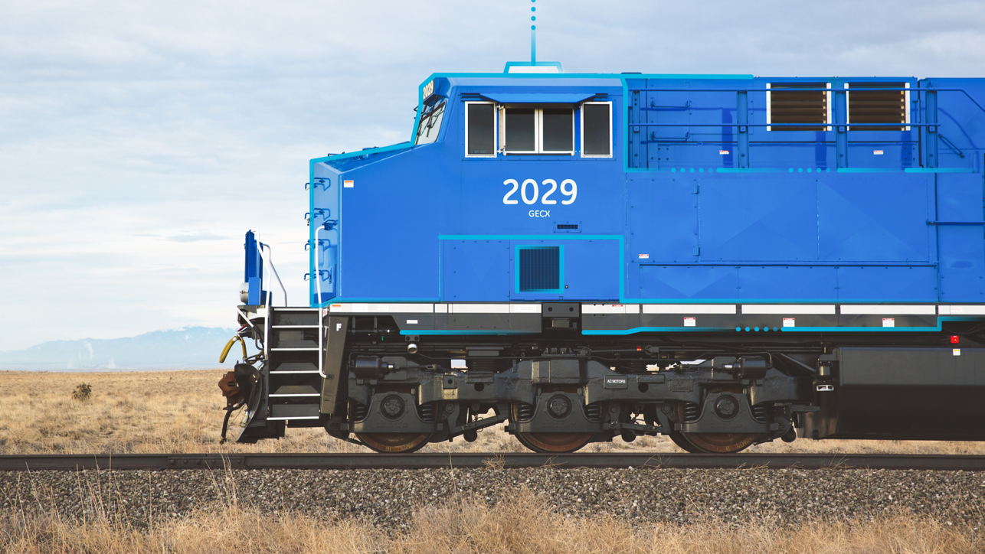

Slide 10

Fun facts about GE
GE Power generates roughly 33% of the world’s electricity
Every two seconds, an aircraft powered by GE takes off
35,000 wind turbines globally
25% of all global hydropower

Slide 11
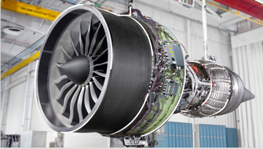
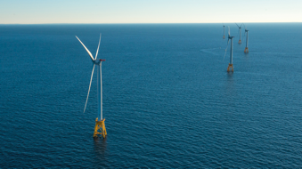
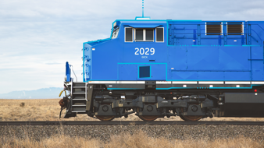
Industrial Internet of Things (IIoT)
GE Assets produce petabytes of useful data
Valuable for gaining insights into these assets
Optimize w/ Asset Performance Management (APM)
Small percent increase in efficiency saves billions of dollars

Slide 12
Predix
Multi-cloud platform for the Industrial Internet of Things
Many services and applications optimized for industrial data

Slide 13
Some Customers
Schindler
Exelon
Rosneft
BP
GE Power
GE Aviation
GE Renewables

Slide 14
Monitoring and Diagnostics Architecture
Edge device/Customer app
Customer Query App
Ingest
HTTP Req
Cloud Gateway (Go)
Query Service (Java)
Publish
Query C*
Apache Kafka
Subscribe
Pipeline (Java -> Go)
Write
Apache Cassandra

Slide 15
Monitoring and Diagnostics Architecture
Edge device/Customer app
Customer Query App
Ingest
HTTP Req
Cloud Gateway (Go)
Query Service (Java)
Publish
Query C*
Apache Kafka
Subscribe
Pipeline (Java -> Go)
Write
Apache Cassandra

Slide 16
Data Pipeline component (Java version)
Stack:
Stateful Java app
Java and Apache Apex
Largest deployment (out of several)
150 Cassandra nodes
30 Kafka nodes
144 Apache Apex containers
Results:
900,000 C* writes/sec (peak)

Slide 17
Data Pipeline component (Go version)
Stack:
Stateless Go app
Cloud Foundry application (k8s in some newer envs)
Prod Configuration (smaller):
9 Cassandra nodes
4 Kafka nodes
32+ Go-Pipeline instances
Results:
450,000 C* writes/sec (peak)

Slide 18
Comparison (Java vs. Go)
Pipeline version | Kafka nodes | C* nodes | Pipeline nodes | Throughput (writes/sec) | AVG Throughput (writes/day) | Environment
Java & Apache | 30 | 150 | 144 | 900,000 (peak) | 77,760,000,000 | Largest production environment
Go (actual numbers) | 4 | 9 | 32 | 450,000 (peak) | 38,880,000,000 | Performance environment
Go (projected) | 30 | 40 | 128 | 1,800,000 (peak) | 155,520,000,000 | Planned production environment

Slide 19
Rewrite motivations
Change in service vision/purpose
Originally – wanted customer specific data models/parsing
Now – standard data model, parsing
Operational cost ($$$)
Managing a Hadoop cluster
Resources (RAM/CPU/Disk)
Moving towards Kubernetes
Simple Go Microservice
We love Go!

Slide 20
Data @ GE
Introduction to Data Pipelines
Sample Data Pipeline in Go
Reliability Testing our Data Pipeline
Results and takeaways

Slide 21
Introduction to Data Pipelines
Move data from one system to another
Perform transformations and business logic
Kafka
Kafka
Custom Microservice
Storm
NATS
Cassandra
CockroachDB
Custom Microservice
Cassandra

Slide 22
Data source: Apache Kafka
Publish/Subscribe messaging system
Parallelized with topic partitions
High throughput
Very widely used
Java, open source - github.com/apache/kafka
App1
Publish
Kafka
Subscribe
App2

Slide 23
Consumer groups Example: 1:1
Consumer group name:
pipeline-group
Topic Name: demo-topic
Kubernetes cluster
Partition 1
go-pipeline-node-1
Partition 2
go-pipeline-node-2
Partition 3
go-pipeline-node-3
Partition 4
go-pipeline-node-4

Slide 24
Consumer groups Example: 2:1
Consumer group name:
pipeline-group
Topic Name: demo-topic
Kubernetes cluster
Partition 1
go-pipeline-node-1
Partition 2
Partition 3
go-pipeline-node-2
Partition 4

Slide 25
Using Kafka with Go
Many libraries github.com/Shopify/sarama + github.com/bsm/sarama-cluster github.com/confluentinc/confluent-kafka-go github.com/segmentio/kafka-go (June 2017)
Chose Sarama + Sarama Cluster
No CGo dependency
Most mature library (at the time)
Wrote internal tooling + documentation around it for ease of use
Pick what works for you

Slide 26
Data store: Apache Cassandra
Column-oriented database
Fault Tolerant - replicated
Scalable
Apple: over 75,000, over 10 PB of data
Netflix: 2,500 nodes, 420 TB, 1 trillion requests
Java, open source github.com/apache/cassandra

Slide 27
Go and Cassandra
github.com/gocql/gocql
For high performance data bindings:
github.com/scylladb/gocqlx

Slide 28
Data @ GE
Introduction to Data Pipelines
Sample Data Pipeline in Go
Reliability Testing our Data Pipeline
Results and takeaways

Slide 29
By show of hands… Who likes the Go Gopher?

Slide 30
I bring to you… Gophers “R” Us

Slide 31
Example: Data Pipeline (Gophers “R” Us)
Gopher sales data
Sensor data
Log data

Slide 32
Data pipeline architecture
Sensor data
Kafka
Publish
Gopher sales data
Publish
Log data

Slide 33
Data pipeline architecture
Sensor data
Kafka
Publish
Purchase data
Publish
Gopher sales data
Log data
Subscribe
Transformation

Slide 34
Data pipeline architecture
Sensor data
Kafka
Publish
Publish
Gopher sales data
Log data
Subscribe
Transformation
Write
Cassandra

Slide 35
Data pipeline architecture
Sensor data
Kafka
Publish
Gopher sales data
Publish
Log data
Subscribe
Transformation
What we’ll focus on
Write
Cassandra

Slide 36
Simplified Application Flow: 3 Easy Steps
for {
select {
case msg := <-consumer.Messages():
event := Transform(&msg)
sink.Write(&event)
}
}
Kafka
Transformation
Cassandra

Slide 37
Subscribing to Kafka
for {
select {
case msg := <-consumer.Messages():
event := Transform(&msg)
sink.Write(&event)
}
}
Kafka
Transformation
Cassandra

Slide 38
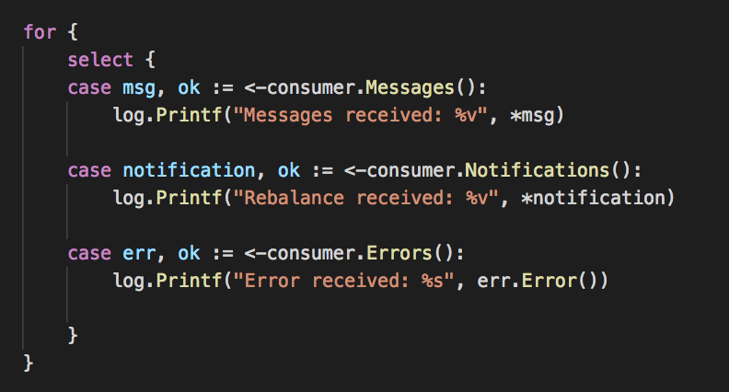
Subscribing to Kafka
Messages channel: Data from Kafka
Notifications channel: Rebalance notifications
Errors channel: Errors in offset management

Slide 39
Handling messages
for {
select {
case msg := <-consumer.Messages():
event := Transform(&msg)
sink.Write(&event)
}
}
Kafka
Transformation
Cassandra

Slide 40
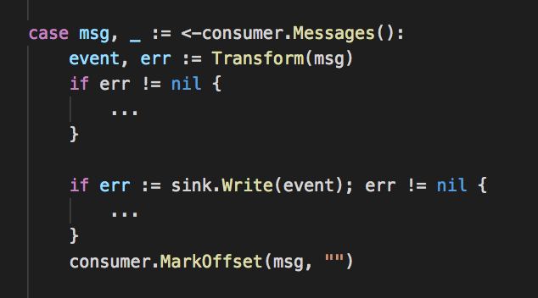
Handling messages
Kafka
Transformation
Cassandra

Slide 41
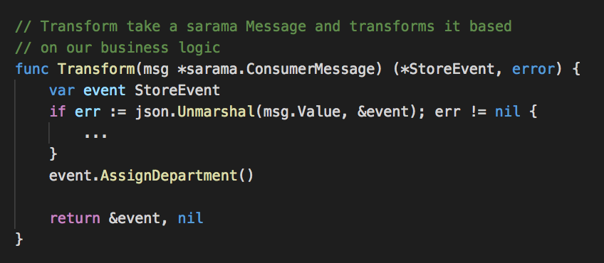
Transforming our message Gophers “R” Us complicated business logic

Slide 42
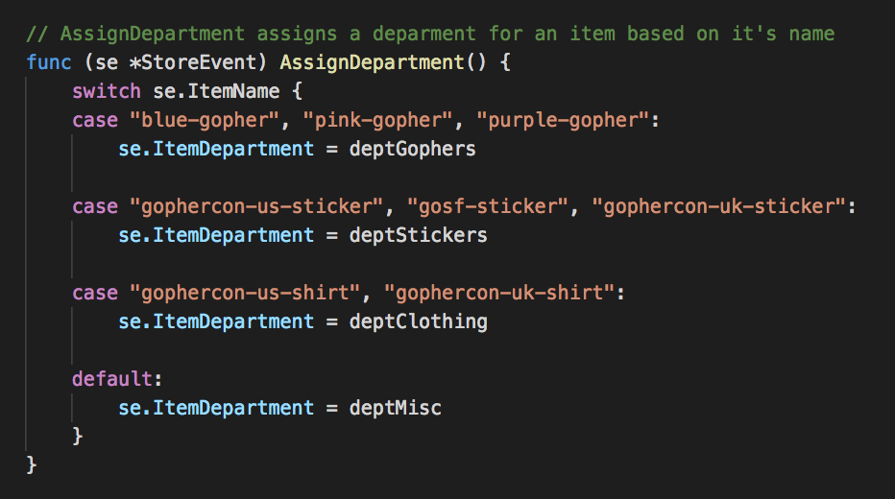
Transforming our message Gophers “R” Us complicated business logic

Slide 43
Writing to Cassandra
for {
select {
case msg := <-consumer.Messages():
event := Transform(&msg)
sink.Write(&event)
}
}
Kafka
Transformation
Cassandra

Slide 44
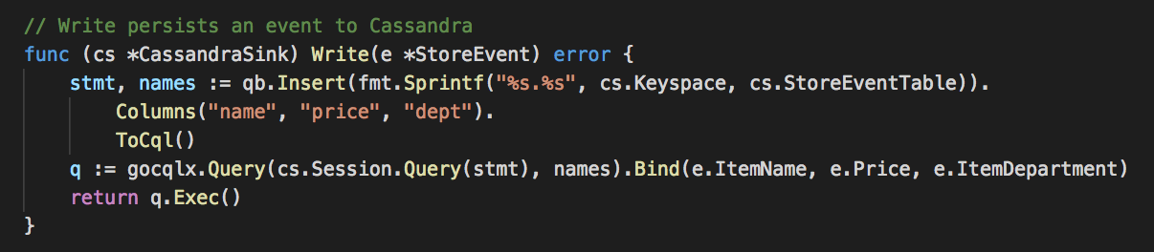
Writing to Cassandra

Slide 45
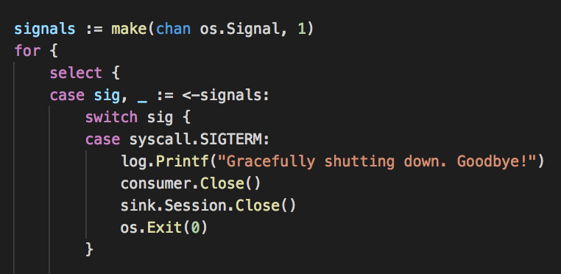
Graceful shutdown
Setup channel for listening to OS Signals
Listen on os signals channel
Handle SIGTERM for graceful shutdown
k8s sends this signal when containers are stopped, scaled down, etc
Grace period (10-30s)
Configurable in k8s: terminationGracePeriodSeconds
Container killed after this period (or you can os.Exit(0) manually)

Slide 46
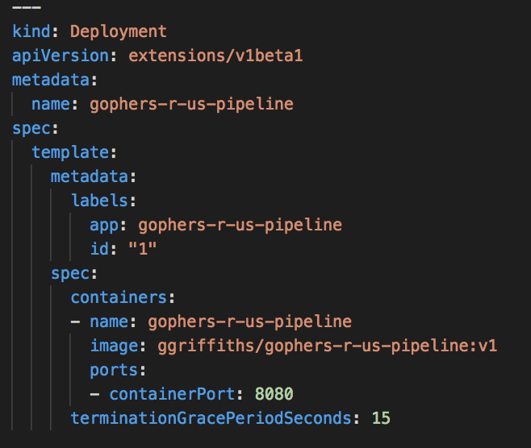
Deploying to Kubernetes

Slide 47
Data @ GE
Introduction to Data Pipelines
Sample Data Pipeline in Go
Reliability Testing our Data Pipeline
Results and takeaways

Slide 48
Reliability Testing
Systems fail
How does our pipeline behave during times like these?
How can we remedy these failures?
How can we ensure customer data is not lost?
Embrace failure scenarios
or they will embrace you at 3 AM
If this interests you: Google SRE Book landing.google.com/sre/book/index.html

Slide 49
Reliability Testing our Data Pipeline
What can fail?
Data pipeline node(s)
Kafka node(s)
Cassandra node(s)
Kubernetes can fail
How does our pipeline behave when this happens?
We can write a test
How can we remedy these failures?

Slide 50
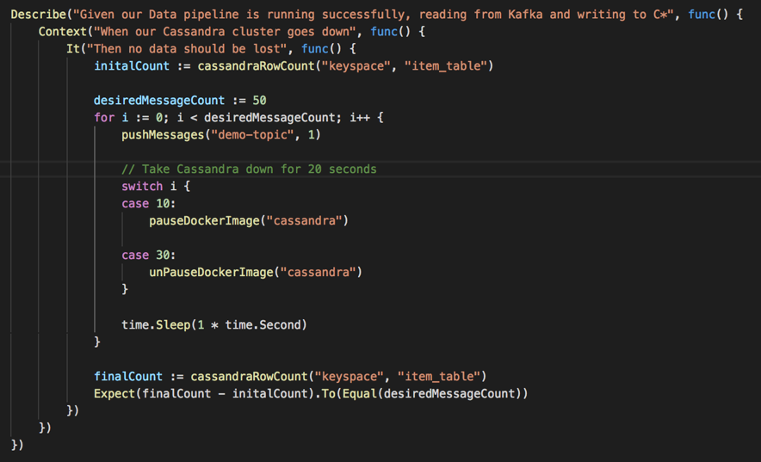
Reliability Test example

Slide 51
Reliability Test example
What else can we test?
Partial cluster failures
Full cluster failures
Pipeline failures
High load
etc
Integration Test with Docker!

Slide 52
Data @ GE
Introduction to Data Pipelines
Sample Data Pipeline in Go
Reliability Testing our Data Pipeline
Results and takeaways

Slide 53
Results & Takeaways
Building Data Pipelines in Go
Simple to get a small app up and running
Good enough community support for Kafka, Cassandra, etc
Use chan of os.Signals for graceful shutdown
Reliability testing
Use docker to integration/reliability test
Understand how your system behaves during failures scenarios
Go Pipelines at GE Digital
Replaced our existing Java pipeline for lower operational cost, simplicity, and performance

Slide 54
Questions?
Or funding for Gophers ”R” Us?

